Slide 1
Process Economics
ECO-302

Slide 2
Disclaimer
All the topics followed in this lecture are from Engineering Economy by R. Panneerselvam 4th Edition, which is being used as a standard textbook for this course. The data taken from the book is entirely for study purposes and no copyright infringement is intended.

Slide 3
Chapter 8 Part 2
Replacement and Maintenance Analysis

Slide 4
REPLACEMENT OF EXISTING ASSET WITH A NEW ASSET
In this analysis, the annual equivalent cost of each alternative should be computed first.
Then the alternative which has the least cost should be selected as the best alternative.

Slide 5

Capital Recovery with Return
Consider the following data of a machine. Let
P = purchase price of the machine,
F = salvage value of the machine at the end of machine life,
n = life of the machine in years, and
i = interest rate, compounded annually
This equation represents the capital recovery with return.

Slide 6
Concept of Challenger and Defender
If an existing equipment is considered for replacement with a new equipment, then the existing equipment is known as the defender and the new equipment is known as challenger.
Assume that an equipment has been purchased about three years back for Rs. 5,00,000 and it is considered for replacement with a new equipment. The supplier of the new equipment will take the old one for some money, say, Rs. 3,00,000.
This should be treated as the present value of the existing equipment and it should be considered for all further economic analysis. The purchase value of the existing equipment before three years is now known as sunk cost, and it should not be considered for further analysis.

Slide 7
EXAMPLE 1
Two years ago, a machine was purchased at a cost of Rs. 2,00,000 to be useful for eight years. Its salvage value at the end of its life is Rs. 25,000. The annual maintenance cost is Rs. 25,000. The market value of the present machine is Rs. 1,20,000. Now, a new machine to cater to the need of the present machine is available at Rs. 1,50,000 to be useful for six years. Its annual maintenance cost is Rs. 14,000. The salvage value of the new machine is Rs. 20,000. Using an interest rate of 12%, find whether it is worth replacing the present machine with the new machine.

Slide 8
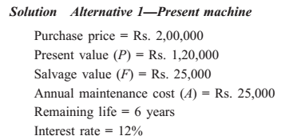
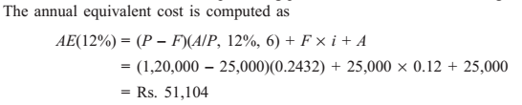

Slide 9
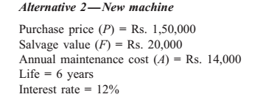
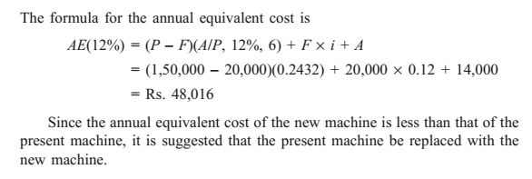

Slide 10
EXAMPLE 2
A diesel engine was installed 10 years ago at a cost of Rs. 50,000. It has a present realizable market value of Rs. 15,000. If kept, it can be expected to last five years more, with operating and maintenance cost of Rs. 14,000 per year and to have a salvage value of Rs. 8,000 at the end of the fifth year. This engine can be replaced with an improved version costing Rs. 65,000 which has an expected life of 20 years. This improved version will have an estimated annual operating and maintenance cost of Rs. 9,000 and ultimate salvage value of Rs. 13,000. Using an interest rate of 15%, make an annual equivalent cost analysis to determine whether to keep or replace the old engine.

Slide 11
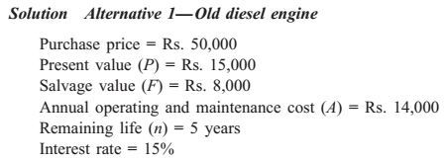
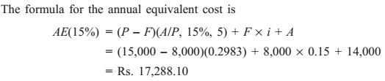

Slide 12
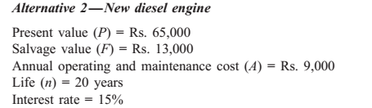
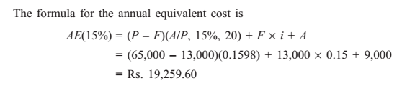


Slide 13
EXAMPLE 3
A steel highway bridge must either be reinforced or replaced. Reinforcement would cost Rs. 6,60,000 and would make the bridge fit for an additional five years of service. If it is reinforced, it is estimated that its net salvage value would be Rs. 4,00,000 at the time it is retired from service. The new prestressed concrete bridge would cost Rs. 15,00,000 and would meet the foreseeable requirements of the next 40 years. Such a bridge would have no salvage value. It is estimated that the annual maintenance cost of the reinforced bridge would exceed that of the concrete bridge by Rs. 96,000. If the bridge is replaced by a new prestressed concrete bridge, the scrap value of the steel would exceed the demolition cost by Rs. 4,20,000. Assume that the money costs the state 10%. What would you recommend?

Slide 14
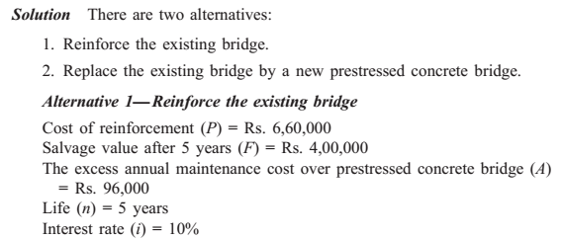
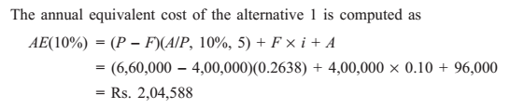

Slide 15
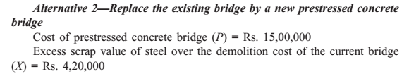
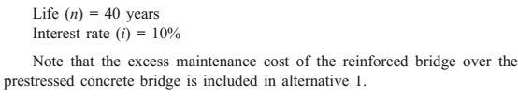
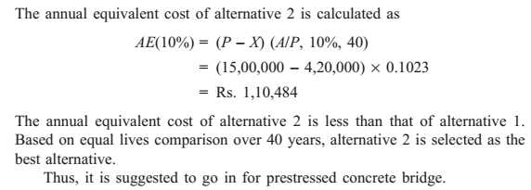

Slide 16
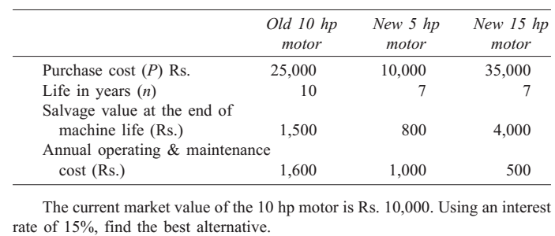
EXAMPLE 4
Three years back, a municipality purchased a 10 hp motor for pumping drinking water. Its useful life was estimated to be 10 years. Due to the fast development of that locality, the municipality is unable to meet the current demand for water with the existing motor. The municipality can cope with the situation either by augmenting an additional 5 hp motor or replacing the existing 10 hp motor with a new 15 hp motor. The details of these motors are now tabulated.

Slide 17
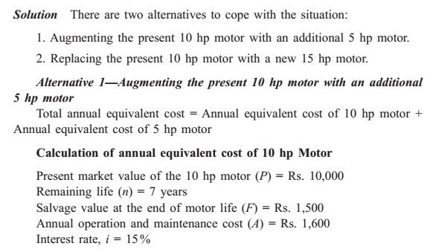
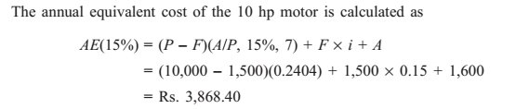

Slide 18
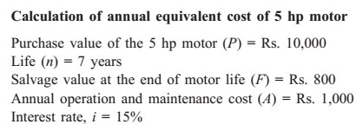
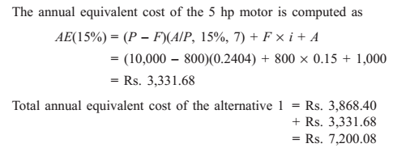

Slide 19
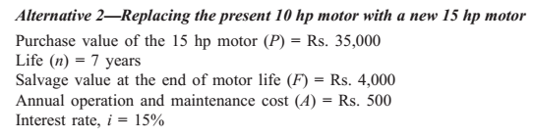
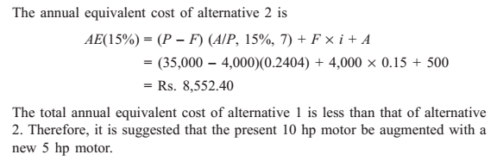

Slide 20
EXAMPLE 5
A machine was purchased two years ago for Rs. 10,000. Its annual maintenance cost is Rs. 750. Its life is six years and its salvage value at the end of its life is Rs. 1,000. Now, a company is offering a new machine at a cost of Rs. 10,000. Its life is four years and its salvage value at the end of its life is Rs. 4,000. The annual maintenance cost of the new machine is Rs. 500. The company which is supplying the new machine is willing to take the old machine for Rs. 8,000 if it is replaced by the new machine. Assume an interest rate of 12%, compounded annually.
(a) Find the comparative use value of the old machine.
(b) Is it advisable to replace the old machine?

Slide 21
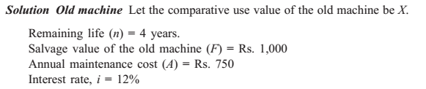
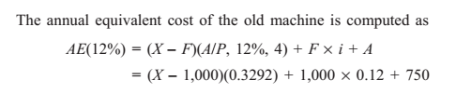
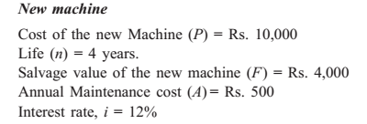

Slide 22
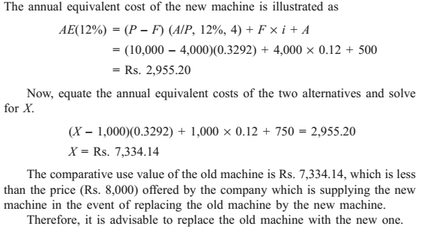

Slide 23
The End

